Slide 1
Jon Palmer’s M-wing Kit
Parts List
The Bionicle elements listed in Dark Orange come in matching pairs in 7 other colors: Black, White, Red, Blue, Green, Dark Turquoise, and Brown.
- 2 Dark Gray Bar 1 x 8 with Brick 1 x 2 Curved Top End (Axle Holder Inside Small End) - 2 Dark Orange Bionicle Mask Kakama - 4 Dark Oange Bionicle Tohunga Foot - 6 Light Gray Brick 1 x 2 - 2 Light Gray Brick 1 x 3 - 1 Light Gray Brick 2 x 2 - 1 Light Gray Brick, Round 2 x 2 - 1 Light Gray Brick, Round 4 x 4 with Holes - 2 Dark Gray Dish 2 x 2 Inverted (Radar) - 1 Trans-Neon Green Dish 2 x 2 Inverted (Radar) - 1 Light Gray Dish 4 x 4 Inverted (Radar) - 1 Light Gray Hinge Brick 1 x 2 Base - 1 Light Gray Hinge Brick 1 x 2 Top Plate Thin - 9 Light Gray Plate 1 x 2 - 4 Light Gray Plate 2 x 2 - 4 Light Gray Plate 2 x 3 - 3 Dark Gray Plate 2 x 4

Slide 2
- 2 Light Gray Plate, Modified 1 x 2 with 1 Stud (Jumper) - 1 Dark Gray Plate, Modified 1 x 2 with 4 x 4 disk at 90 degrees - 3 Trans-Neon Green Plate, Round 1 x 1 - 2 Light Gray Plate, Round 2 x 2 with Rounded Bottom (Boat Stud) - 2 Light Gray Slope 18 4 x 2 - 1 Light Gray Slope 45 2 x 1 Triple - 2 Light Gray Slope, Inverted 33 3 x 1 - 1 Light Gray Slope, Inverted 33 3 x 2 with Connections between Studs - 1 Light Gray Slope, Inverted 45 4 x 4 Double - 1 Black Technic, Axle 3 - 2 Light Gray Technic, Axle and Pin Connector Angled #1 - 2 Light Gray Technic, Axle and Pin Connector Perpendicular - 1 Dark Gray Technic, Brick 1 x 2 with Axle hole - 2 Light Gray Technic, Brick 1 x 2 with Hole - 2 Light Gray Technic, Brick 1 x 2 with Holes - 4 Black Technic, Pin Long with Friction Ridges Lengthwise - 4 Black Technic, Pin with Friction Ridges Lengthwise - 1 Black Tile 1 x 2 with Avionics SW Copper, Red & Silver Pattern - 2 Light Gray Tile 1 x 2 with SW Computer Pattern - 1 Dark Gray Tile 1 x 4 with Black, Silver, Copper Circuitry Pattern - 2 Light Gray Tile, Modified 1 x 2 Grille with Bottom Groove / Lip - 2 Trans-Neon Green Tile, Modified 1 x 2 Grille with Bottom Groove / Lip - 1 Light Gray Wedge 4 x 4 Triple Inverted - 2 Light Gray Wheel Freestyle with Technic Pin Hole - 1 Trans-Black Windscreen 6 x 4 x 2 Wedge Curved

Slide 3
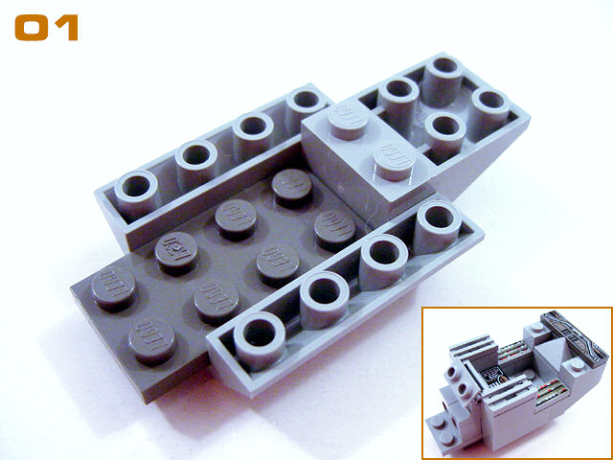
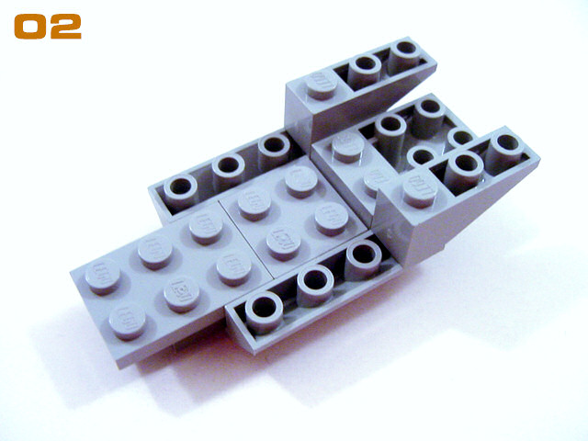
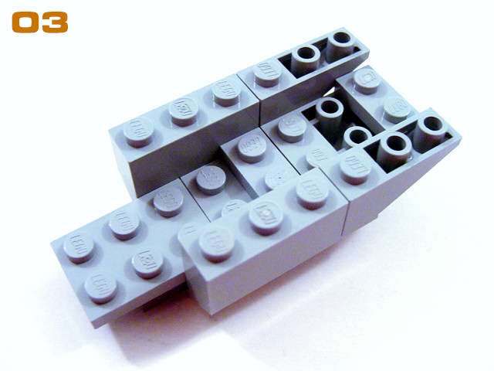
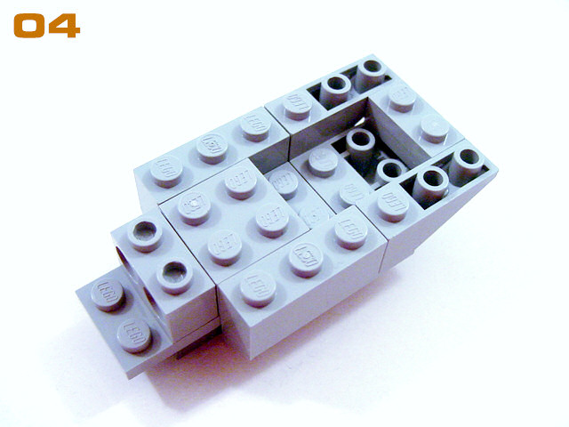

Slide 4
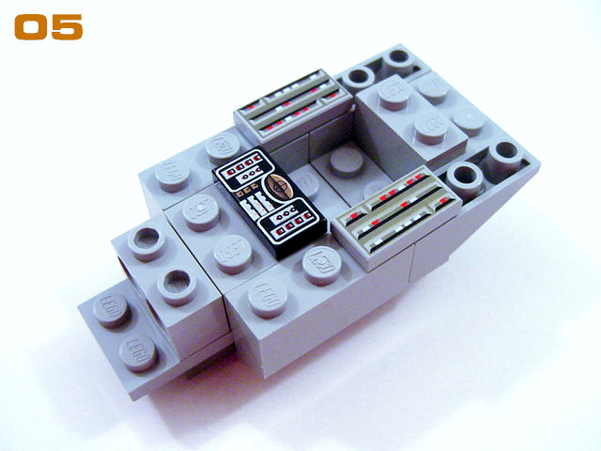
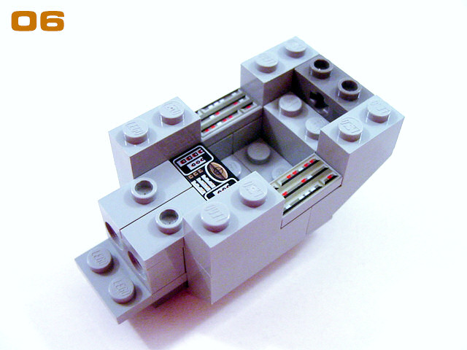
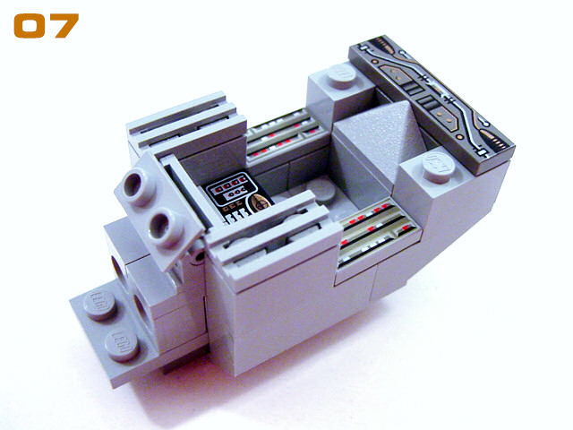
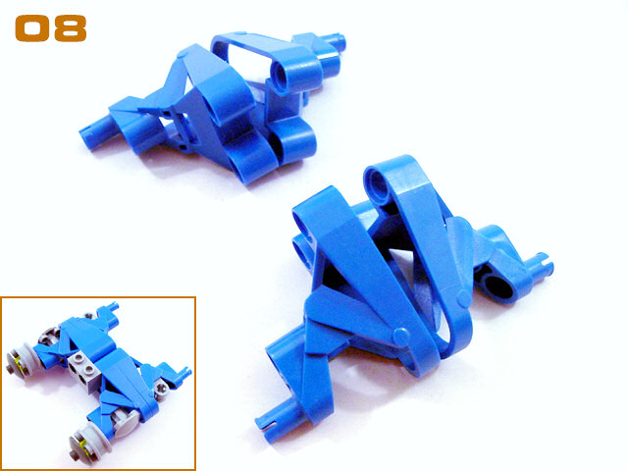

Slide 5
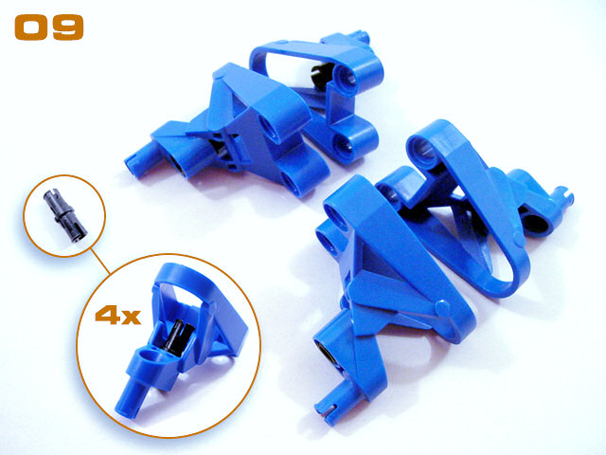
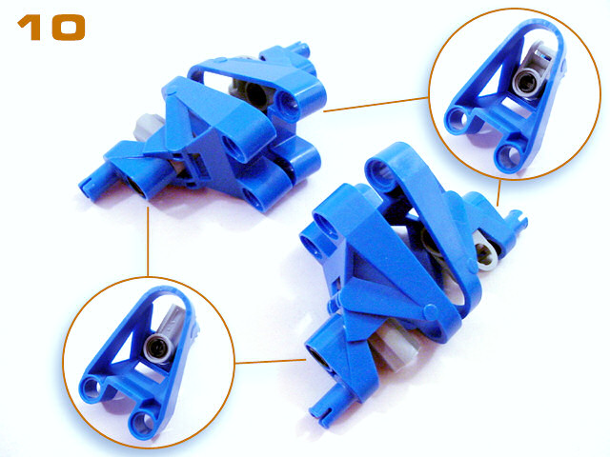
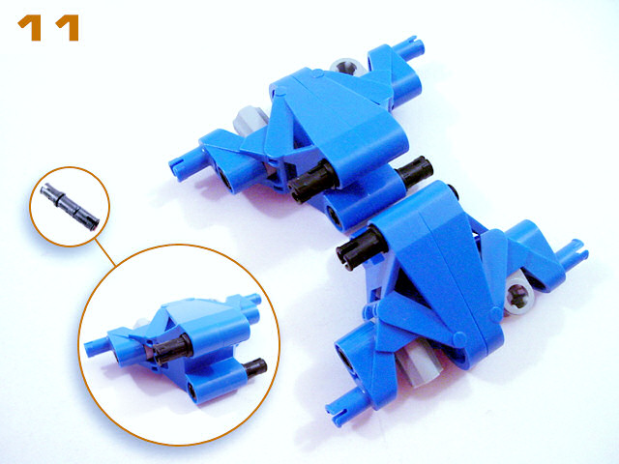
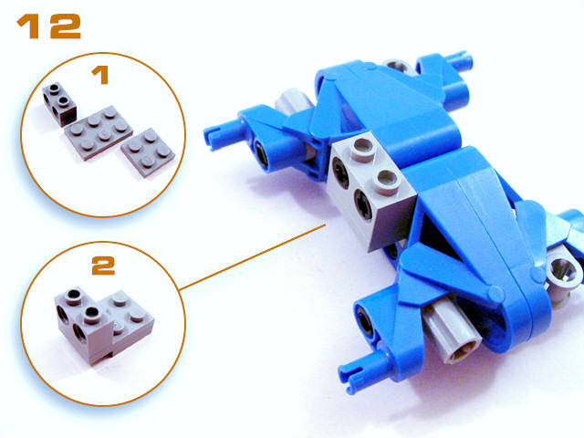

Slide 6
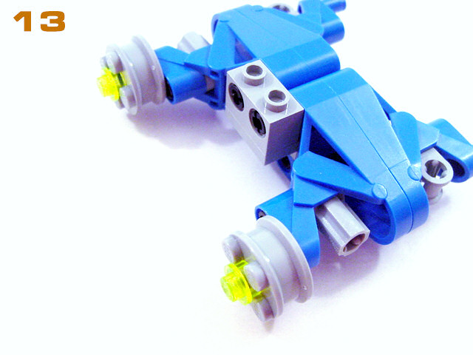
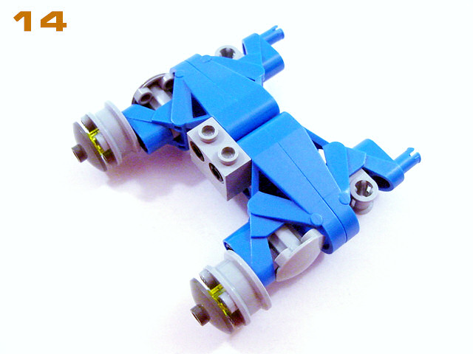
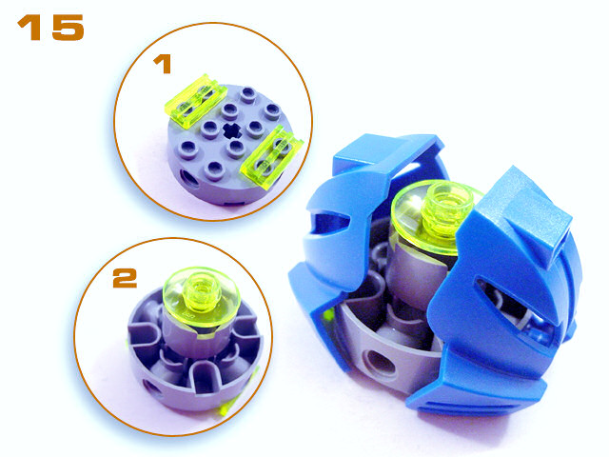
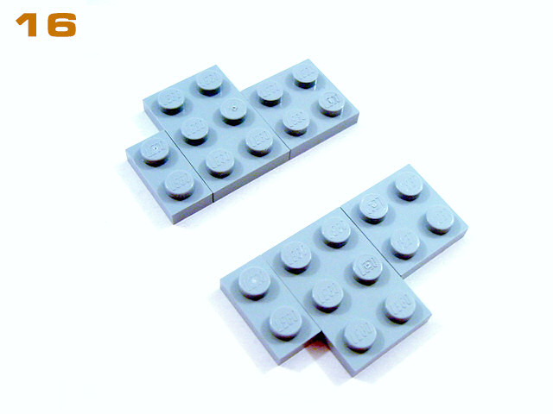

Slide 7
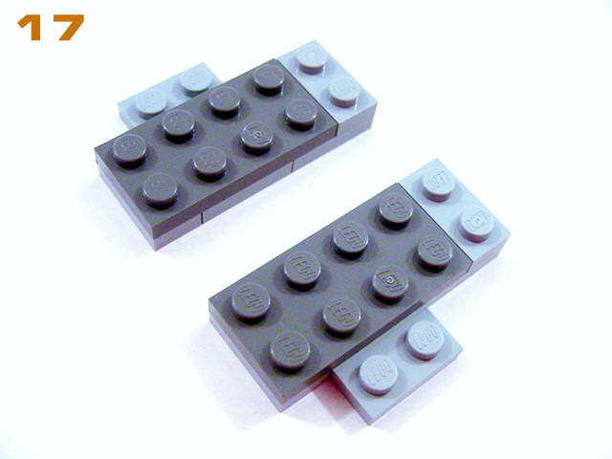
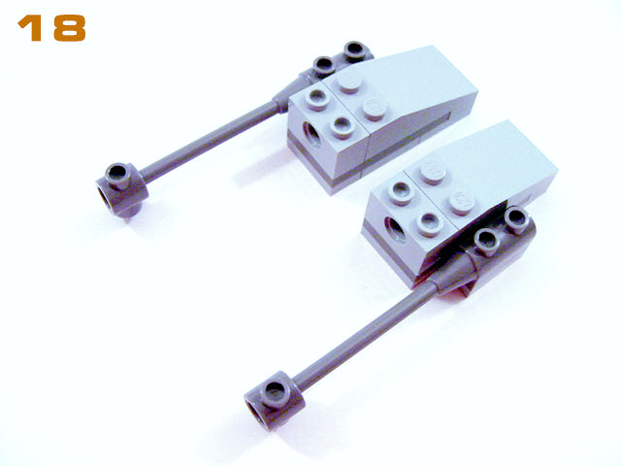
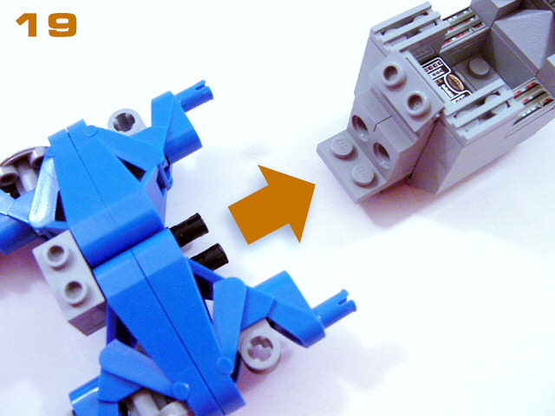
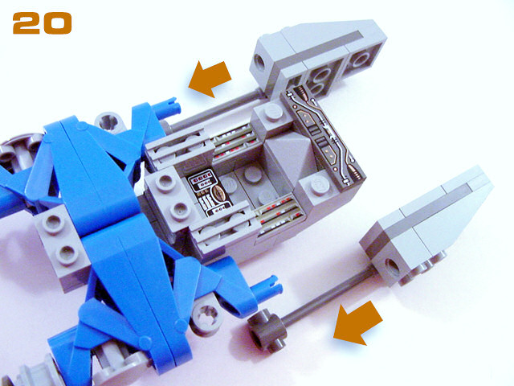

Slide 8
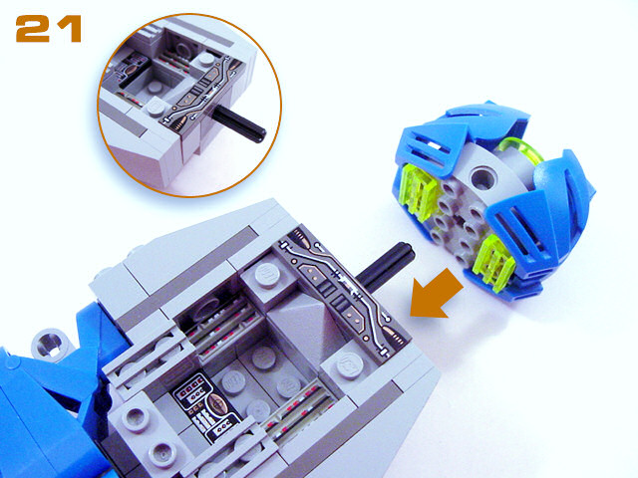
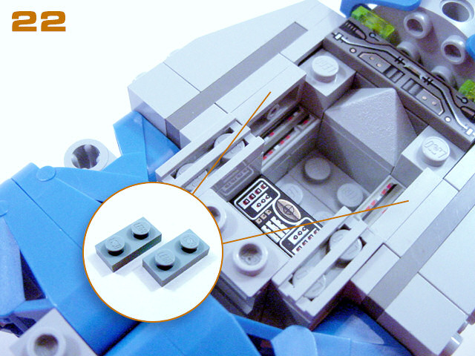
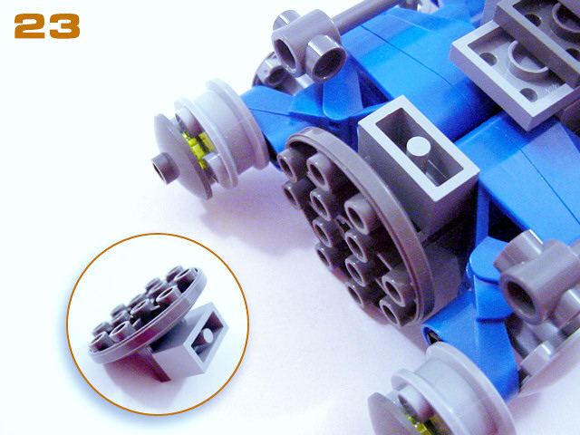
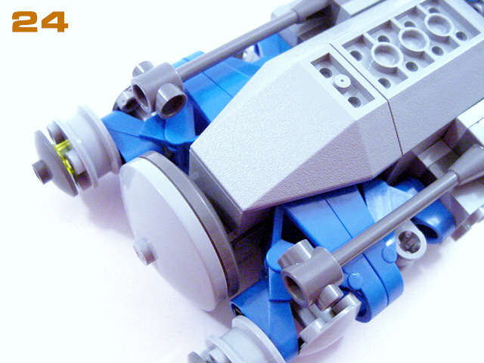

Slide 9
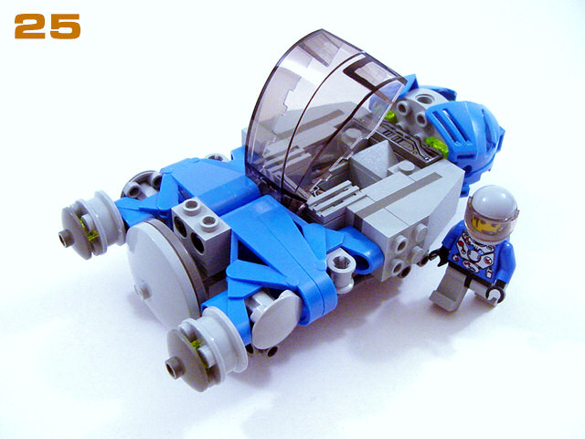
Swoosh Away!

